Slide 1
Wine Tasting Note Generator
A NLP Language Generation Model

Slide 2
Table of Contents
01
Problem Statement
05
Exploratory Data Analysis
02
06
Models Created
Flask Deployment
03
07
What Makes a Tasting Note?
Final Model Evaluations
04
08
Conclusions
Dataset Sources

Slide 3
Problem Statement
Create a Machine Learning Model capable of creating believable wine tasting notes given an initial seed

Slide 4
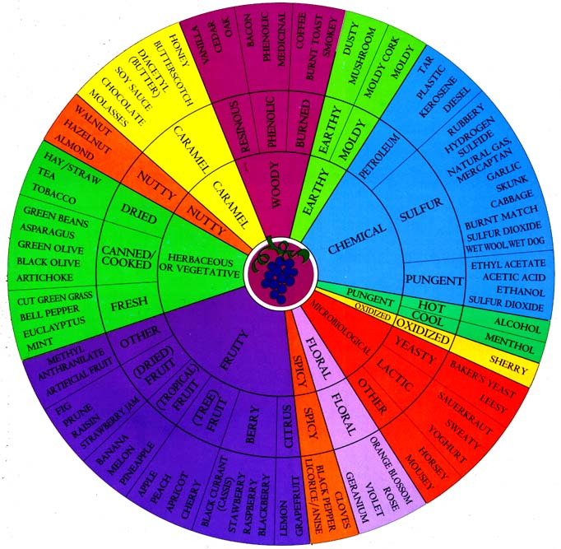
UC Davis Wine Aroma Wheel
Introduced in 2002
Classifies major aromas of wine
Provided a way to recreate each aroma with common food items to standardised descriptions

Slide 5
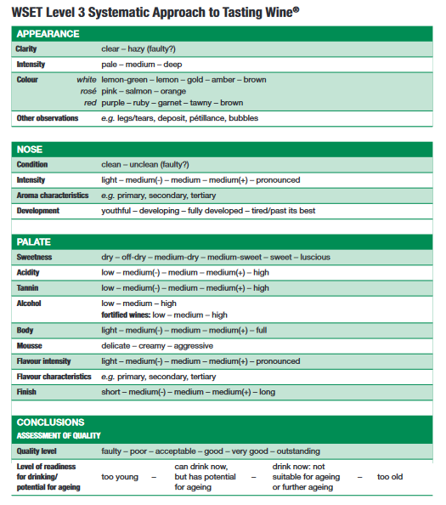
WSET Wine Tasting Rubric
In 2016, WSET introduced their systematic approach to tasting for professionals in the industry
Categories:
Appearance
Nose
Palate
Conclusion

Slide 6
Anatomy of a Tasting Note
Appearance
Aroma
Mouth feel/Texture
Personal Thoughts

Slide 7

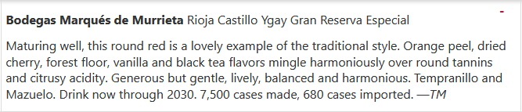
Appearance
Aroma
Mouth feel/Texture
Personal Opinions

Slide 8
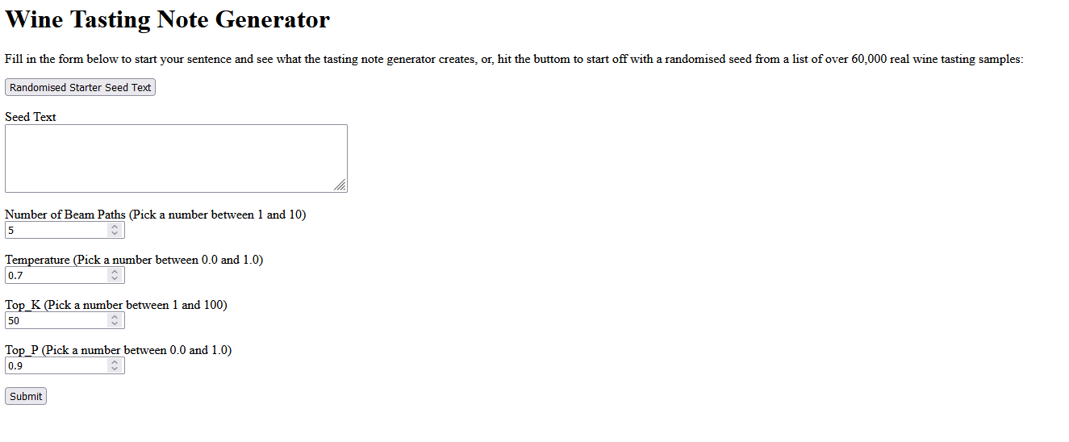
Flask API – Wine Note Generator

Slide 9


Data Sources
Data was extracted from Tasting Notes from the following sources:
Wine Spectator Top 100 Wines
Wine Advocate/Robert Parker
Vinous
Scrapped over 80,000 Tasting Notes

Slide 10
Wine Note Length & Tasting Note Variation
Wine Note Lengths
Similar Wine Notes
Wine note lengths ranged from under 10 words to over 800 words
Short tasting notes were sometimes scores with a “Recommended” Tag for the note
Shorter notes under 25 words were cut to provide the model with notes of longer length, as well as to later be able to compare generated notes with ground truths based on an initial seed text
Long notes had many personal anecdotes and notes above 75 were cut
Wine notes that were similar but not duplicate fell into 2 categories:
Wine was named based on region with the same year
Similar tasting notes for wines of different vintages from the same winery
Both were ultimately kept as there was enough variation
48,000 rows of data remaining

Slide 11
MODELS

Slide 12
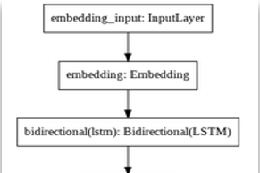


MODEL 1
“Most Basic Model” Dataset: Trained on Wine Spectator Data only ~About 2200 rows of data Topology: 2 LSTM layers stacked on each other Generated text: Aromatic and beautiful harmonious with black tea notes that are in good harmony supported by light tannins and prominent acidity offers a beautiful mouthfeel that coats the palate and invites you back for another sip drink now through 2027 500 cases imported

Slide 13
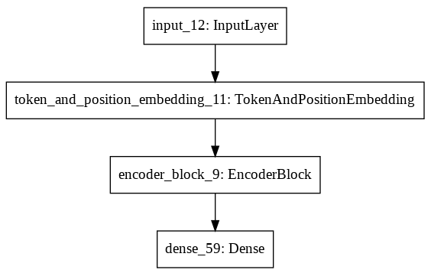
MODEL 2
Transformer Encoder Block
Dataset: Trained on the Entire Data Set ~About 48,000 rows of data Topology:
Token Embedding
Positioning Embedding
4x Encoder Layers:
Multi Head Attention
Dropout
Normalisation
Feed Forward layer
Dropout
Normalisation
Generated text:
Aromatic and beautiful but the the the on good the and finishes dark and nose of a berry of offering with a to an by this palate

Slide 14
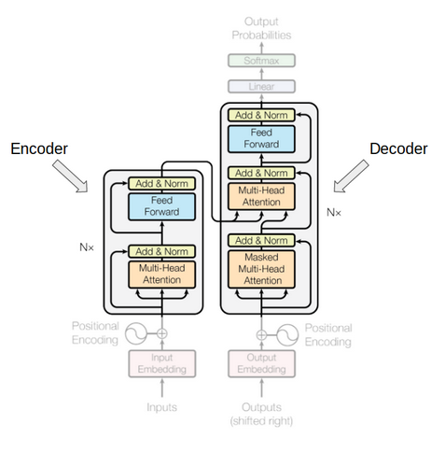
MODEL 3
Pre-trained DistilGPT2 Model
Dataset: Trained on the Entire Data Set ~About 48,000 rows of data
Parameters:
Beam paths: 5
Temperature: 0.7
Top_k: 50
Top_p: 1
Generated text:
Aromatic nose combines blackberry, licorice, violet, menthol and wild herbs. Juicy, spicy and intense, with a restrained sweetness to the flavors of dark berries, licorice and bitter chocolate. Finishes with substantial tongue-clean

Slide 15
Model Performance – ‘Aromatic’ Seed
Model | Generated Text
Model 1 | Aromatic and beautiful harmonious with black tea notes that are in good harmony supported by light tannins and prominent acidity offers a beautiful mouthfeel that coats the palate and invites you back for another sip drink now through 2027 500 cases imported
Model 2 | Aromatic and beautiful but the the the on good the and finishes dark and nose of a berry of offering with a to an by this palate
Model 3 | Aromatic nose combines blackberry, licorice, violet, menthol and wild herbs. Juicy, spicy and intense, with a restrained sweetness to the flavors of dark berries, licorice and bitter chocolate. Finishes with substantial tongue-clean

Slide 16
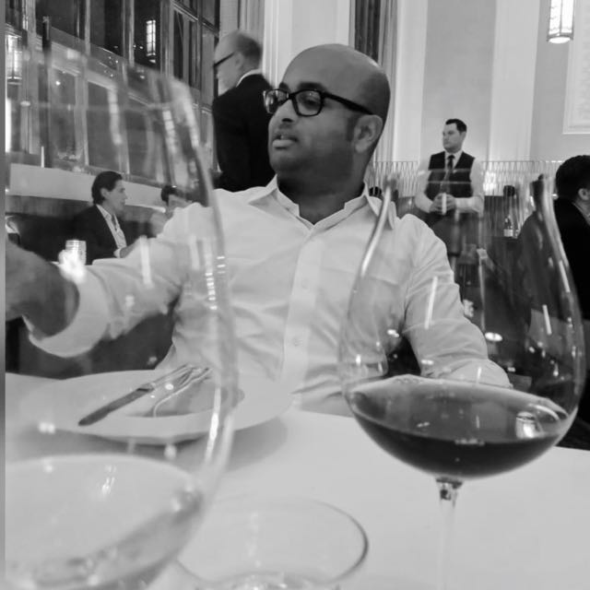


Model Performance – 2 are generated
Predominantly dark fruit and berries with a distinct blackcurrant and slightly herbaceous nose. Hint of anise and other spices. On the palate quite silky with soft mild tannins and medium acidity. Short, slightly bitter finish.
Ruby-red. A fragrant bouquet evokes red berry preserves, violet and vanilla, along with smoke and mineral overtones. Juicy and precise on the palate, offering sweet raspberry and cherry flavors and a hint of candied rose. Closes on a spicy note, with very good clarity and length.
A riper more floral and perfumed (violets) nose, with the blackcurrant making an appearance again, but not much in the way of spice. Feels even softer than the St. Estephe on the palate. Again, mild tannins with a short and slightly bitter finish.
Primary, lots of wood. A bit musty with air oddly enough but goes away. almost salty (but not green nor stemmy). Quite nice though, lots of freshness. Power, ripeness but very slick. Soft. Plummy finish with a touch of chocolate. Lovely sage brush. Really quite nice.
The 2015 Cabernet Sauvignon (Rutherford) is a powerful, imposing wine. Super-ripe black cherry, gravel, licorice, spice and menthol infuse the 2015 with tons of depth and intensity. The tannins are a bit rough around the edges, but there is plenty to look forward to here.

Slide 17
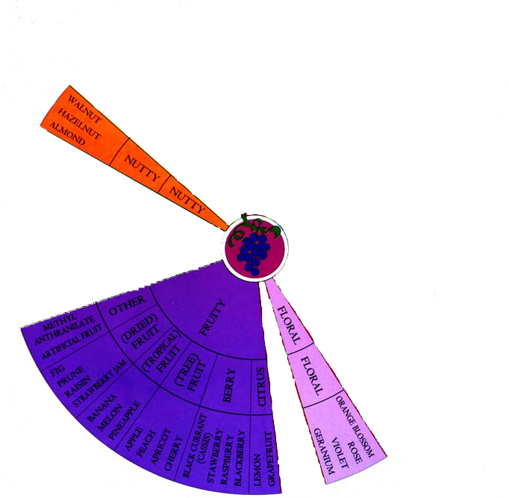
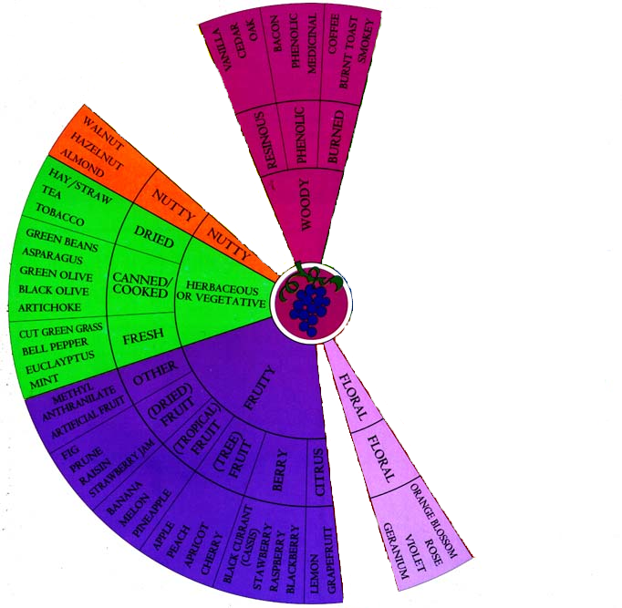
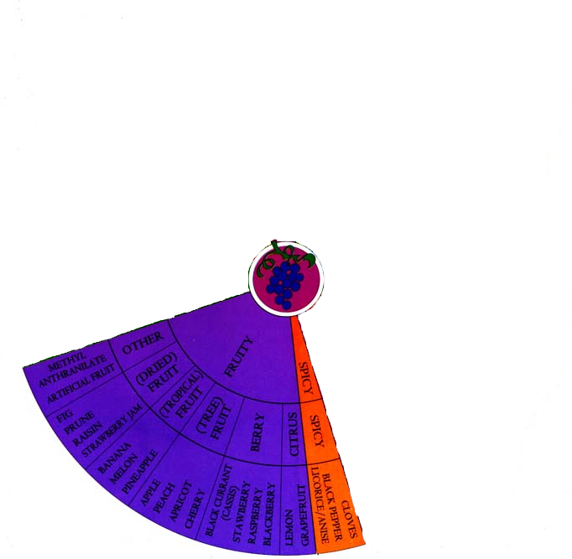
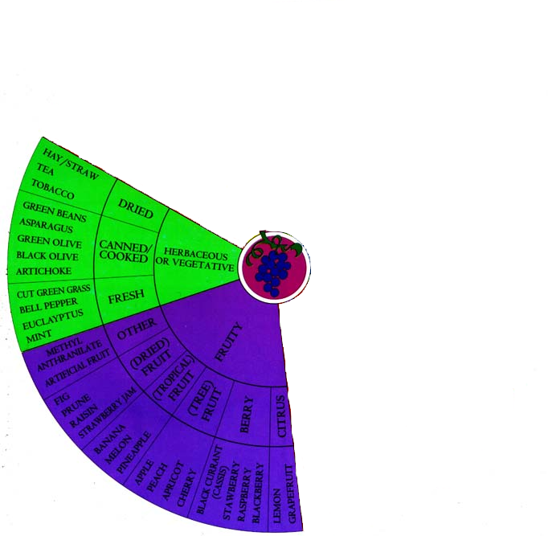
Model Performance – ‘Start Seed’
Generated Text | Ground Truth
Elegant aromas of cherry, apple blossom and hazelnut. Sweet and almost creamy on the palate, with a creamy texture to the flavors of apple, pear and hazelnut. Finishes with a fine dusting of tannins. | Elegant aromas of cherry, apple blossom and hazelnut. Sweet and almost creamy on the palate, tinged with herbs, nuts and vanilla. Fine balance and an underlying sense of slate give this Riesling its charm.
The 2020 Sainte-Marie Vieilles Vignes (Entre-Deux-Mers) has a clean, quite precise nose of apple orchard fruit and light flinty aromas. The palate is well balanced with a fine bead of acidity, a fine bead of acidity and a harmonious, lightly spiced finish. Excellent. | The 2020 Sainte-Marie Vieilles Vignes (Entre-Deux-Mers) has a clean, quite precise nose of apple orchard and light grass clipping scents. The palate is citrus-fresh on the entry with veins of orange pith and light touches of lemongrass, and a soft landing on the finish.

Slide 18
Conclusions
The DistilGPT2 model performed remarkably well, providing grammatically correct sentences with good punctuation, although occasionally it would end off in gibberish
The simpler models performed better with LSTMs versus Multi Head Attention in an encoder block
As the data grew, the model took too long to run due to the increasing parameters and size of the vocabulary – LSTM models took 3 hours per epoch on the full data set
LSTM models required the data to be split – The sentence “I am a dog” would become:
Multi Head Attention was able to examine the relationship of the word to the rest of the sentence, requiring data to only be streamed into 1 X and 1 Y, which allowed a much faster model run time
Words prior | Word Predicted
I | Am
I am | A
I am a | dog

Slide 19
Improving the Model
To improve the Multi Head Attention model, the introduction of a 1d convolutional layer could be used, with the kernel size to dictate the window of words used
Using pooling layers to reduce parameters may be another possible approach to reduce the complexity of the overall model
Train the model on a wider variety of tasting notes using a crowd sourced platform like Vivino
Controlled Text Generation allowing the input of region and vintage to help guide the type of text generated

Slide 20
DANKE!
Habt ihr noch Fragen?
youremail@freepik.com
+39 620 421 838
yourcompany.com
Bitte lösche diese Folie nicht, es sei denn du bist ein Premium Nutzer

Slide 21
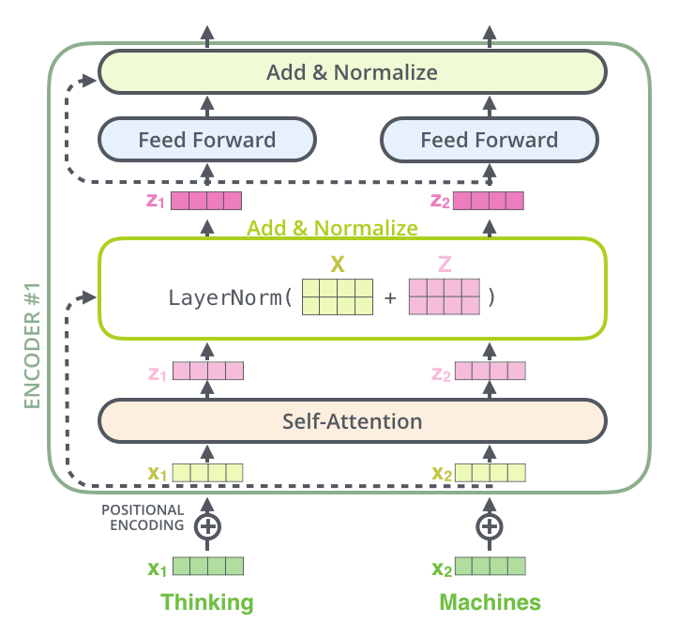
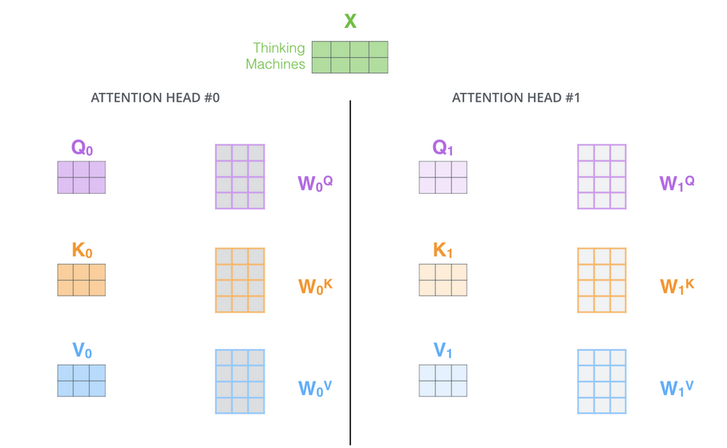
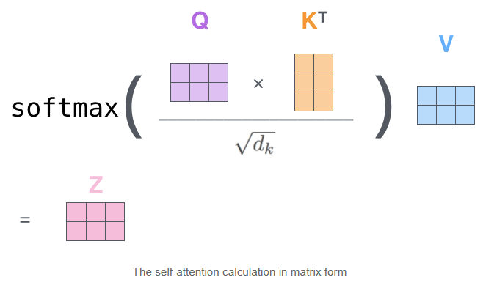
Appendix: Transformer Encoding Block
Multi-Head Attention
Input: ‘Thinking Machines’
Query, Key, Value

